Slide 1

Cross-Country Abortion Travelers in Germany
What “Foreigners” in German abortion statistics can tell us
Niklas Pawelzik, Justus v. Samson, Alvaro Guijarro May

Slide 2
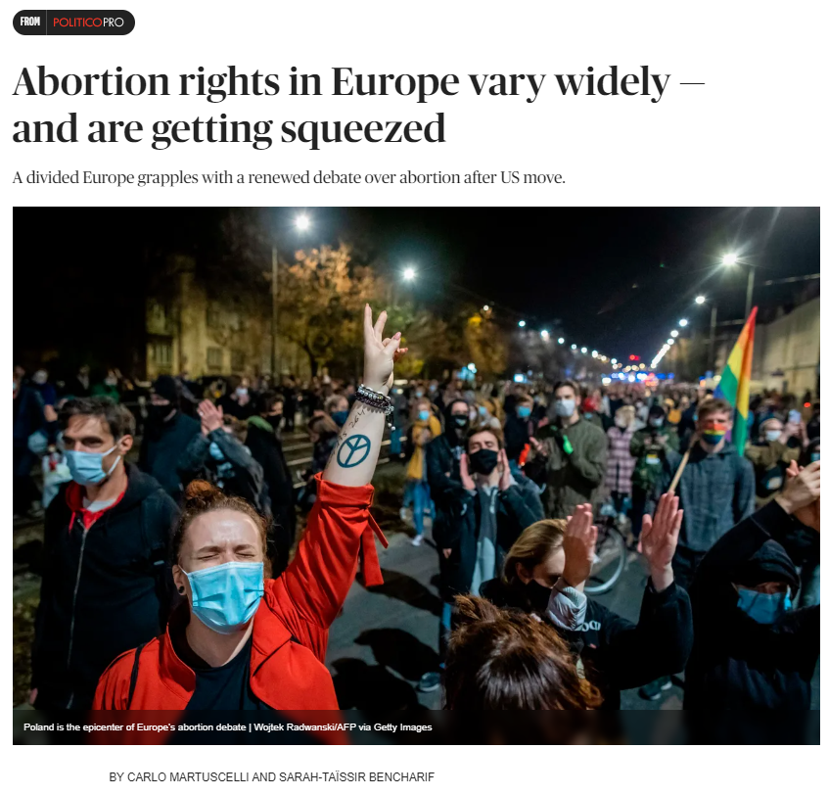
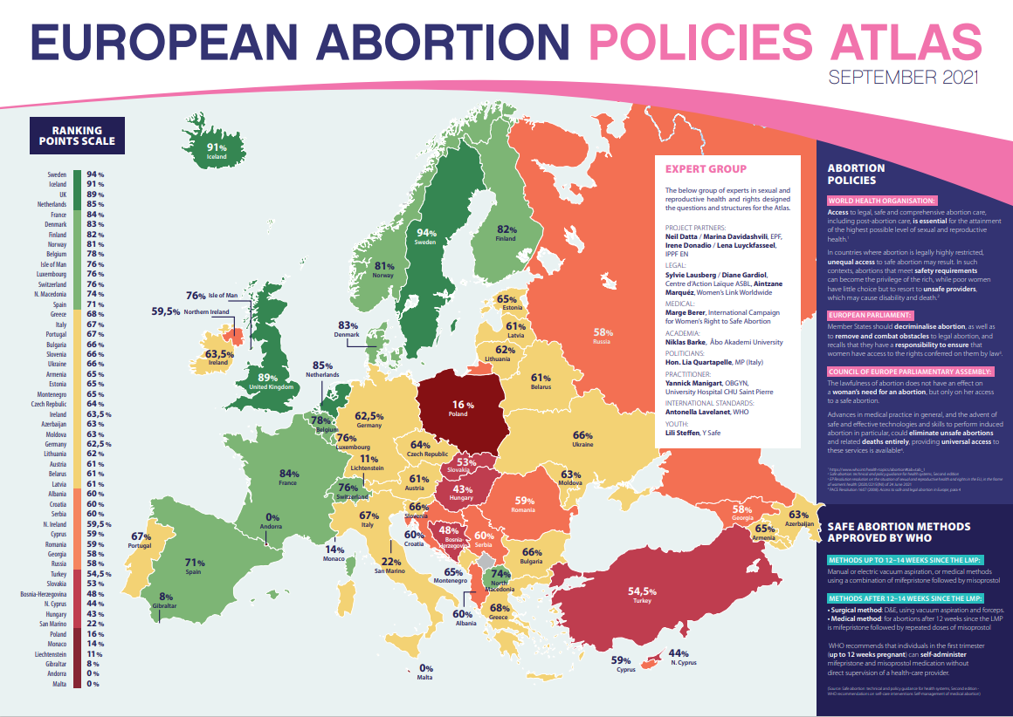

Notes:
Describe the issue
Map: Abortion atlas
Headline: Divided Europe, abortion rights in Europe vary widely, Polish Protests
Slogan: Abortion Without Borders organizations

Slide 3
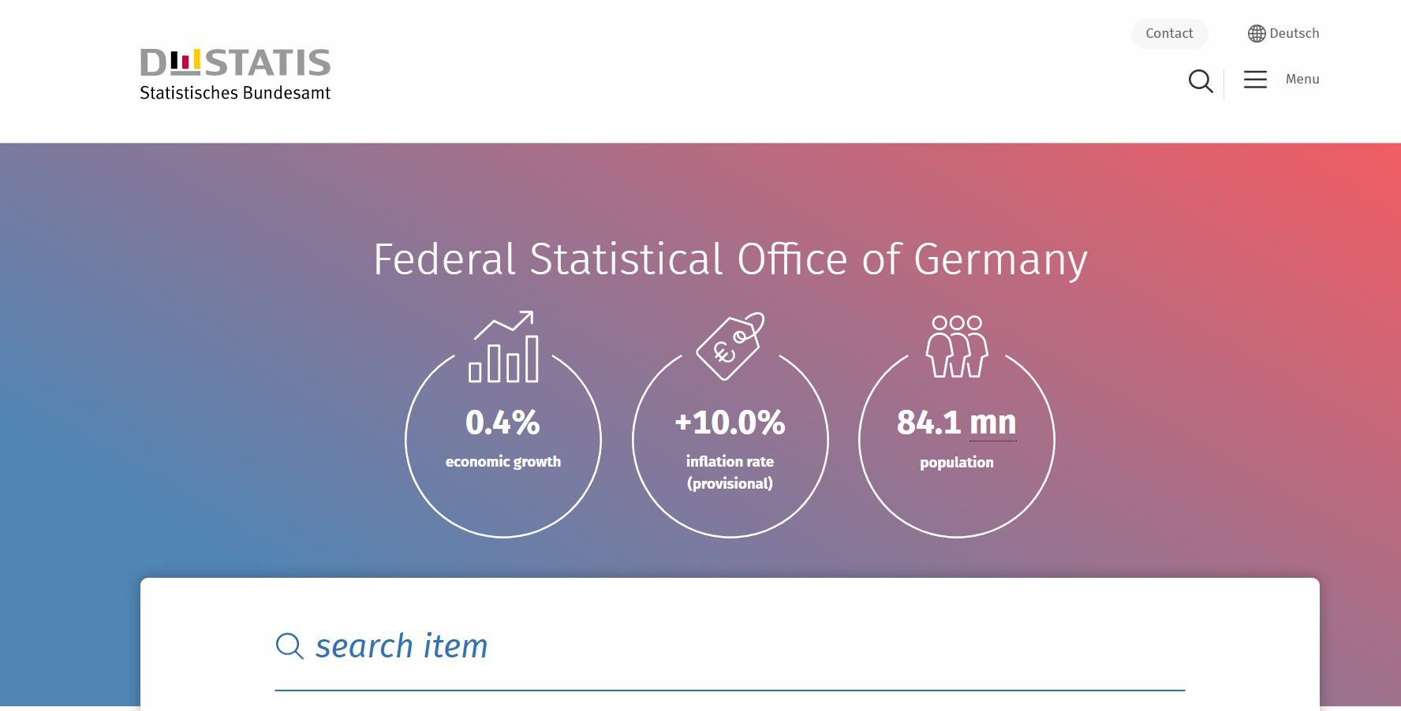
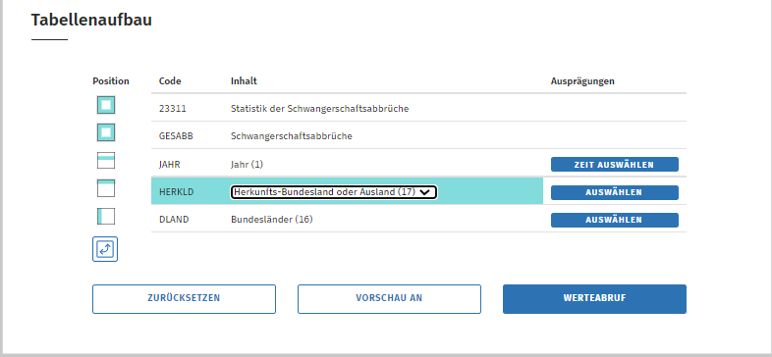
No official Polish numbers…
Limited official German numbers…
Unofficial numbers are estimations
Notes:
What do we want to know? Why don´t we know it already?
Place to go: Federal Statistical Office of Germany
„State of Origin“ or „Foreign“
Only info: Foreign. Not where from, and under what circumstances
No official numbers
Unofficial numbers: no complete info, only estimations
Studies
NGOs
Doctors/Practioners

Slide 4
Classifier Model
If Polish women travel, they appear in German statistics
Polish ban leads to increased foreign abortions?
Look at abortions… can we predict whether they are foreign or German?
Model assigns
group prediction
Notes:
Why ML needed?
„no complete info, only estimations“
ML can be of great help when it comes to estimating!
Info available: Abortion performed on German or Foreign woman?
If Polish women travel, they appear in Germany/German statistics
If Polish women decide to go abroad (to Germany):
Where do they go (how do they decide to go/based on what info)?
They go to more permissive places
They go to places nearby
They go to places with existing (Polish) social networks

Slide 5
Abortion in German state (Länder)
Share Migrant
Share Foreign
Border Distance
Prediction:
Origin Abortion Seeker
State (Länder) level information
For all neighbouring countries
Factor in the restrictiveness of those countries
Notes:
Three Factors for State-level Explanatory Variables:
1. Share Migrant Background
2. Share Foreigners
3. Distance to border
For all neighbouring countries, factor in the restrictiveness of those countries
Result: Most important Factor: Distance to border

Slide 6
Success of Predictions
Abortions on Germans
Abortions on Foreigners
Abortion detected
Abortion not detected

Slide 7
References
Abortion Without Borders (2022): Abortion Without Borders. Abortion Without Borders organizations. In: Abortion Without Borders. Last access via https://abortion.eu/#organisations on 8th December 2022.
European Parliamentary Forum for Sexual & Reproductive Rights (2021): The European Abortion Policies Atlas. Last access via https://www.epfweb.org/sites/default/files/2021-09/ABORT%20Atlas_EN%202021-v5.pdf on 8th December 2022.
Federal Statistical Office of Germany (2022): Schwangerschaftsabbrüche: Bundesländer, Jahre, Familienstand/Herkunfts-Bundesland oder Ausland. Last access via https://www-genesis.destatis.de/genesis/online?operation=previous&levelindex=3&levelid=1670339337649&levelid=1670339127827&step=2#abreadcrumb on 8th December 2022.
Martuscelli, Carlo/Bencharif, Sarah-Taïssir (2022): Abortion rights in Europe vary widely — and are getting squeezed. In: Politico. Last access via https://www.politico.eu/article/abortion-right-europe-vary-widely-getting-squeezed/ on 8th December 2022.
O'Neill, Sean (2021): Animating Your Assemblies Like a Champion. Last access via https://my.solidworks.com/reader/wpressblogs/2021%252F09%252Fanimating-your-assemblies-like-a-champion.html/animating-your-assemblies-like-a-champion on 8th December 2022.

